Slide 1
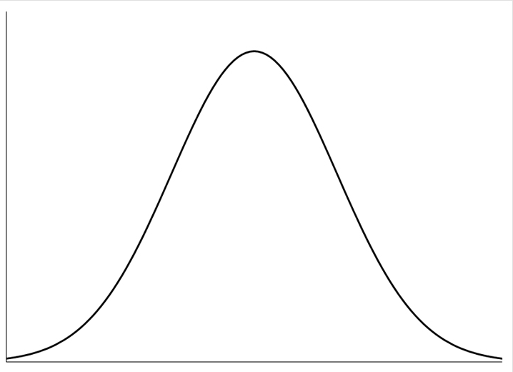
Null hypothesis
Range/distribution of expected values of sample results, if the null hypothesis is true

Slide 2
Null hypothesis
p < .05; null hypothesis unlikely to be true
Range/distribution of expected values of sample results, if the null hypothesis is true

